Slide 1



Autonomous car
By: Youssif mohamed amin
Ahmed mohamed ibrahim
Omar moaenes yehia
Group Nasr 35

Slide 2
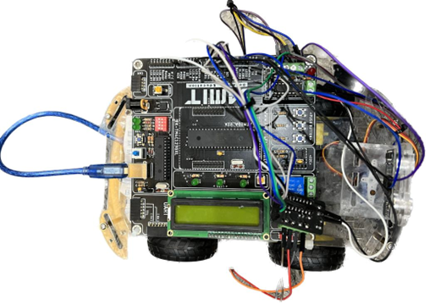
introduction
The autonomous car avoids collision with its surroundings by using a sensor to stop it at a certain distance, then a servo motor attached to the sensor will rotate it 180 degrees to check left and right sides for which position to move to. If the left side distance is greater than right side distance then the robot will turn left and move at the direction, and vice versa. These actions continues indefinitely.
Attached to the robot is a 16x2 LCD that consistently tells the direction the robot is currently heading and the data currently obtained from the Ultrasonic sensor

Slide 3
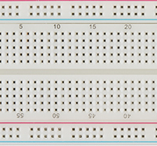
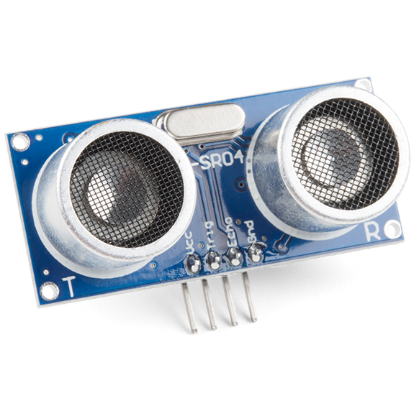
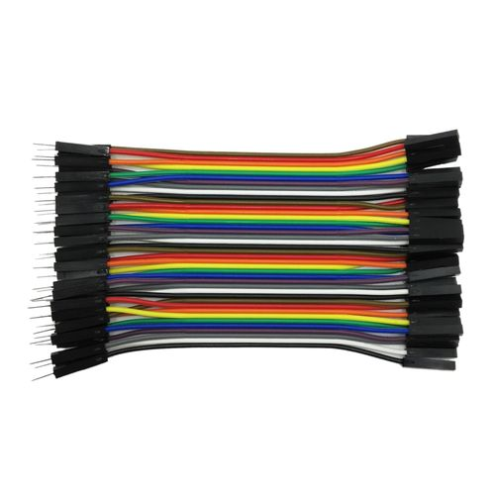
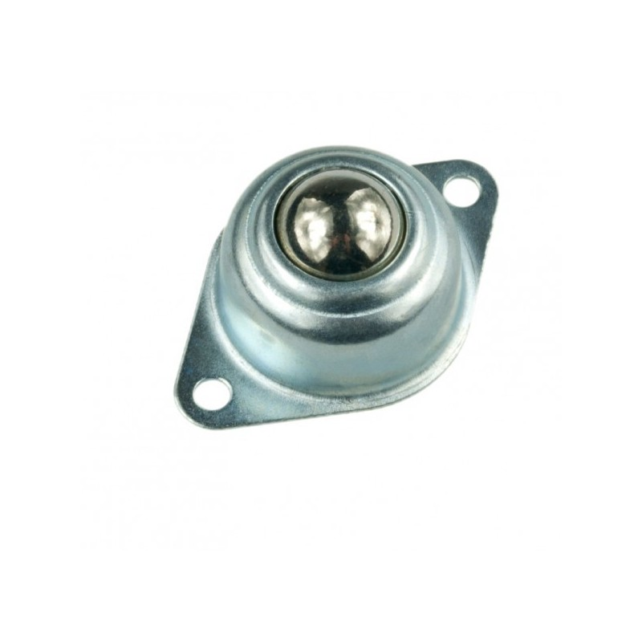
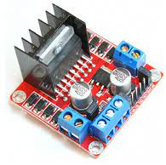
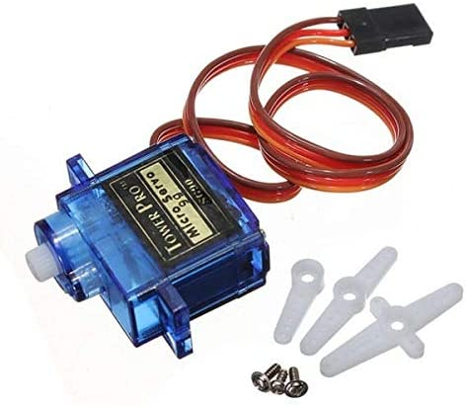
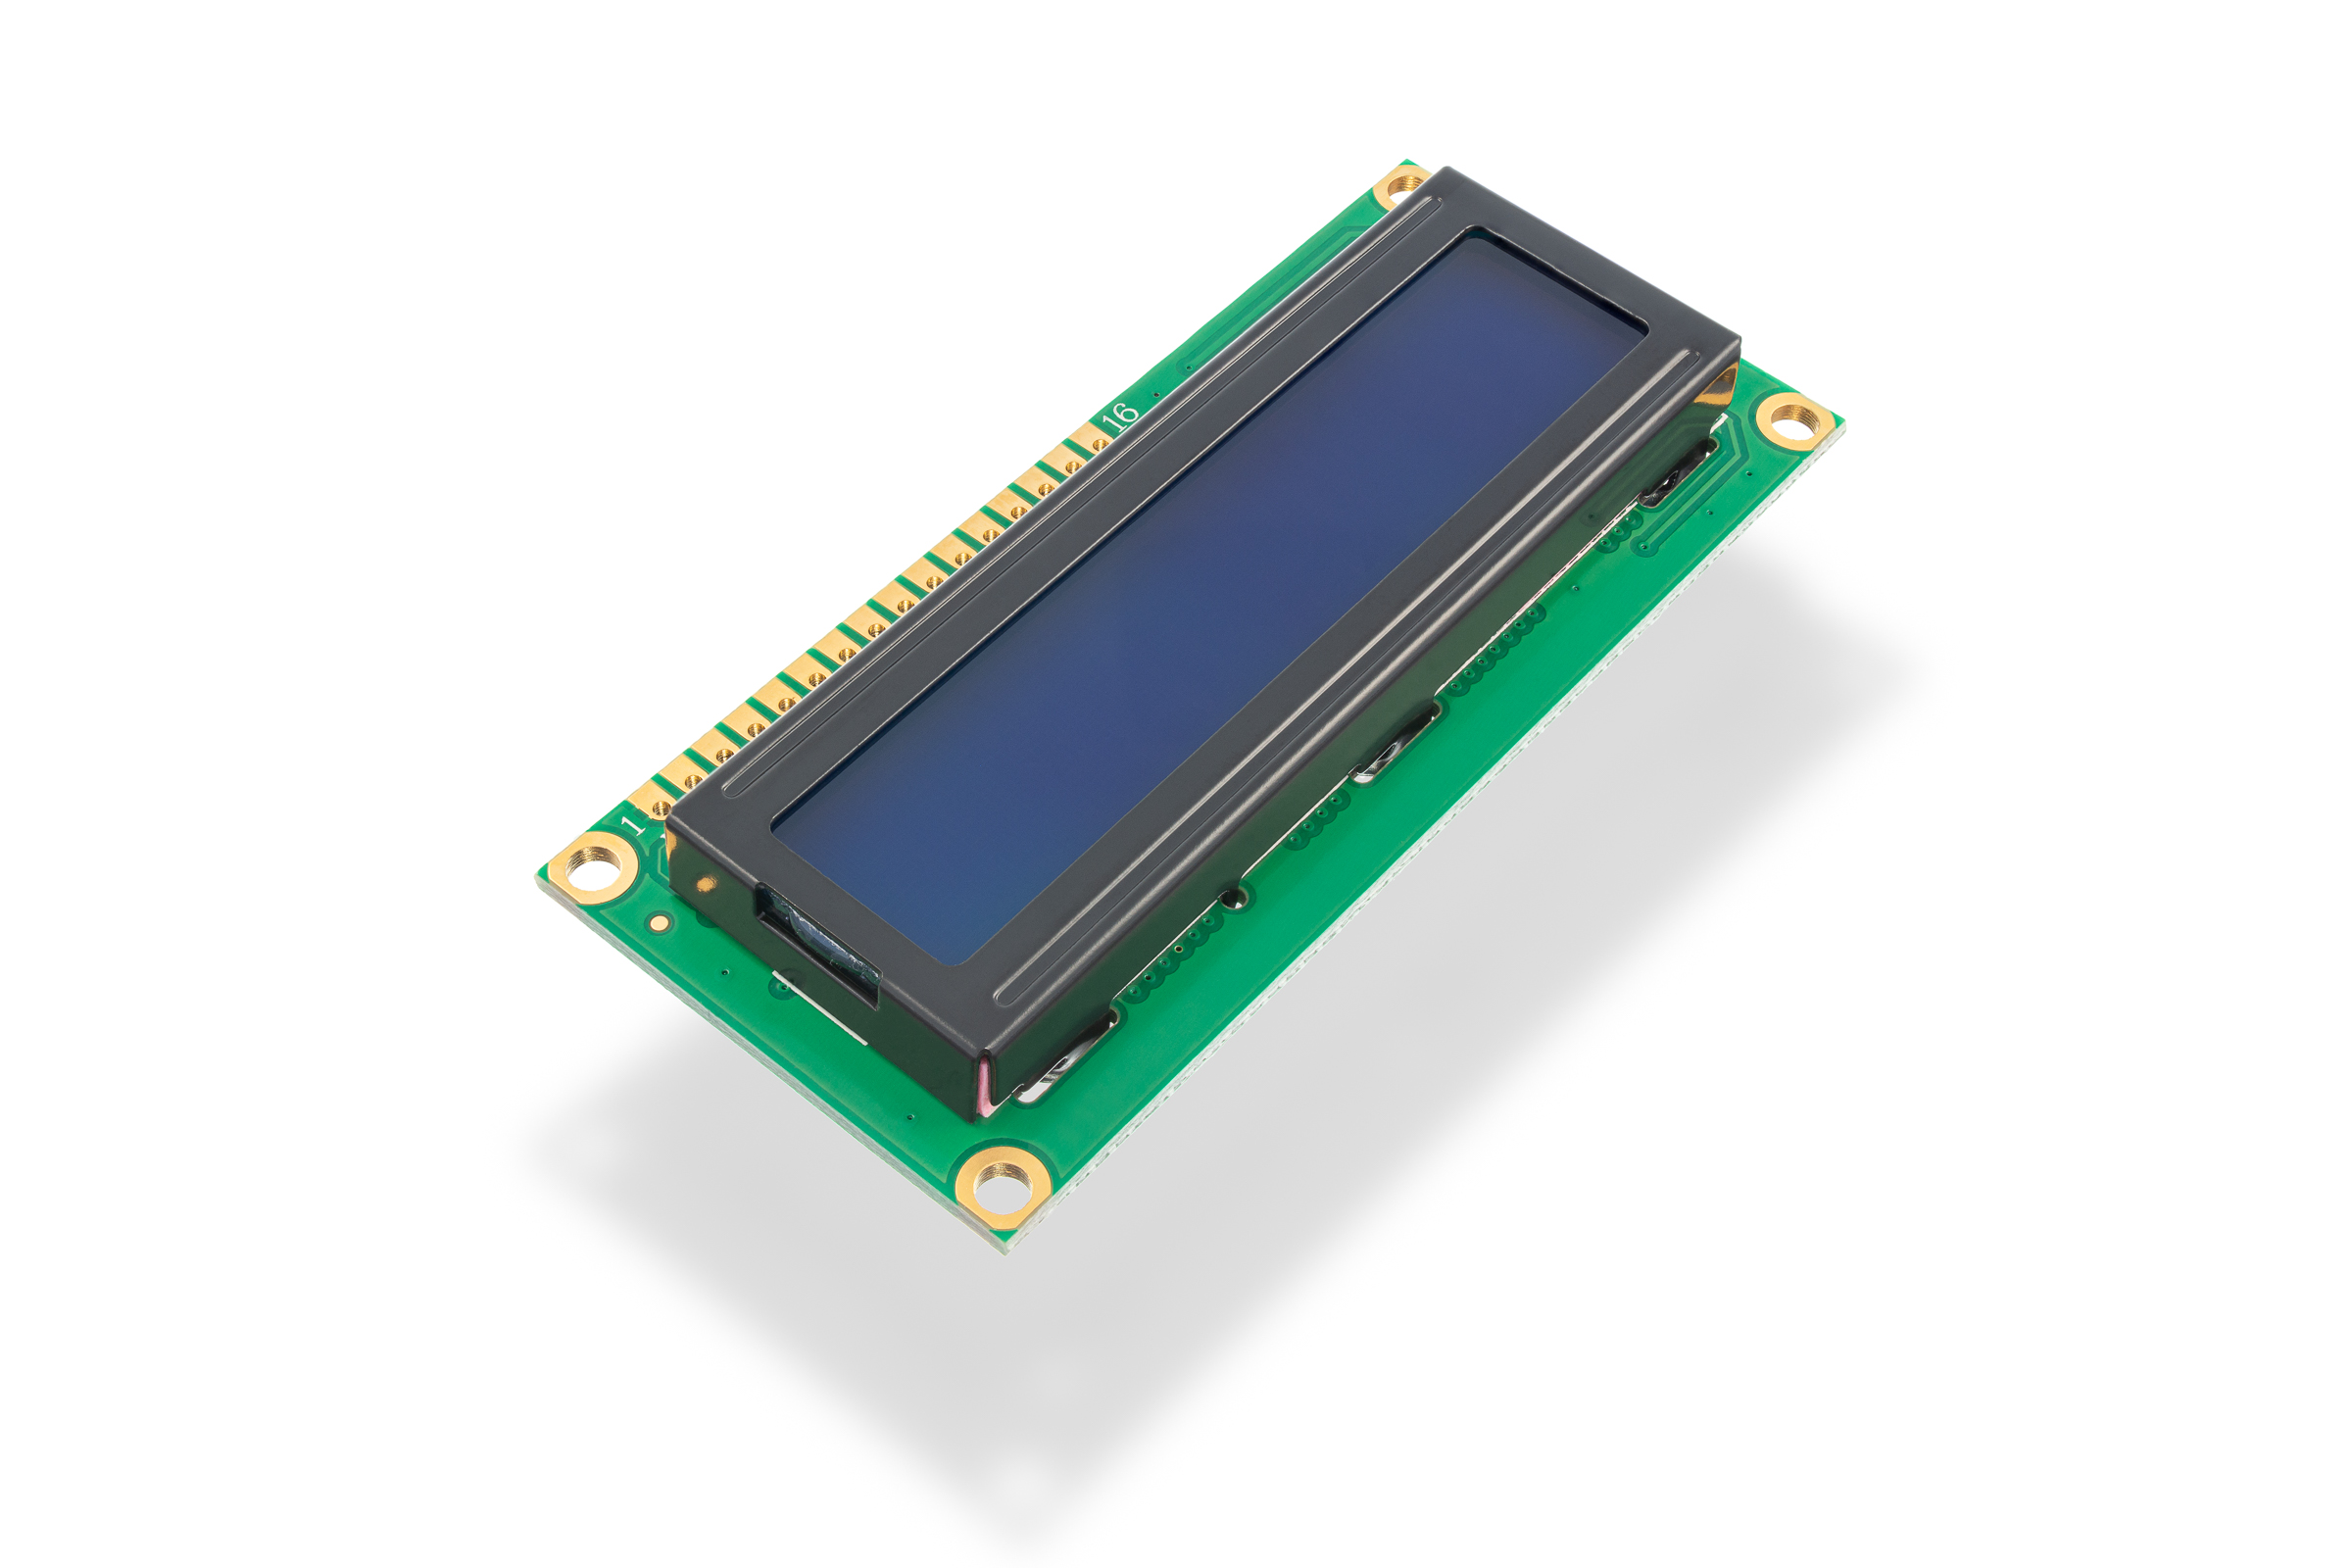
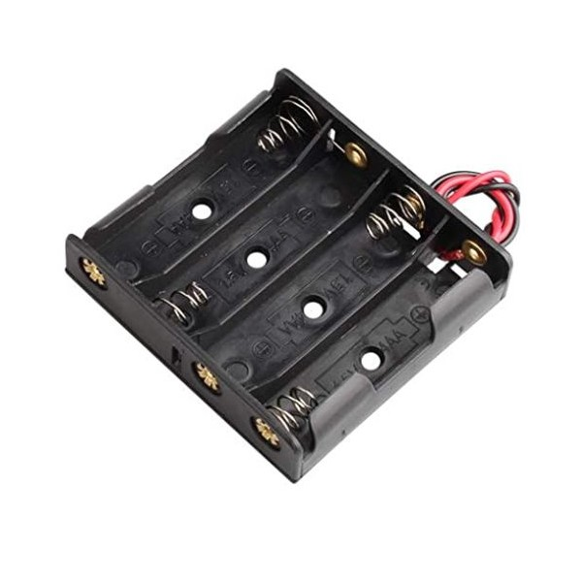
Components
Caster wheel
Breadboard
Ultrasonic sensor
Jumpers
L293D Chip (motor driver)
Servo motor
LCD
Battery holder (4 batteries)

Slide 4
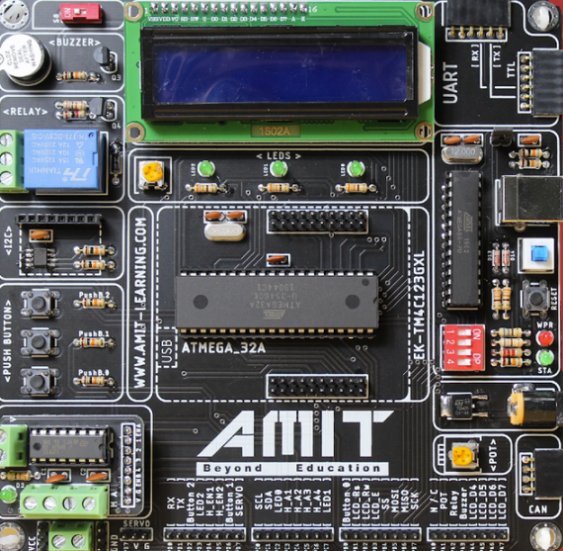
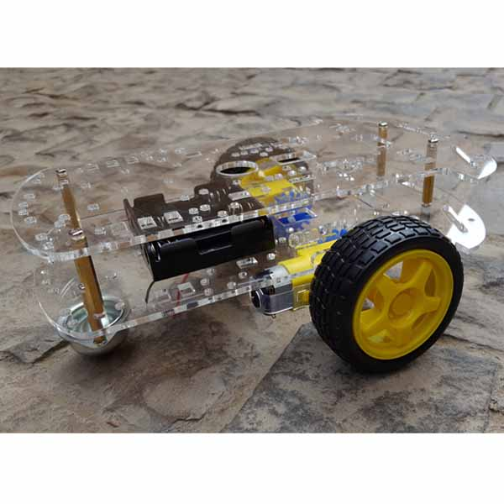
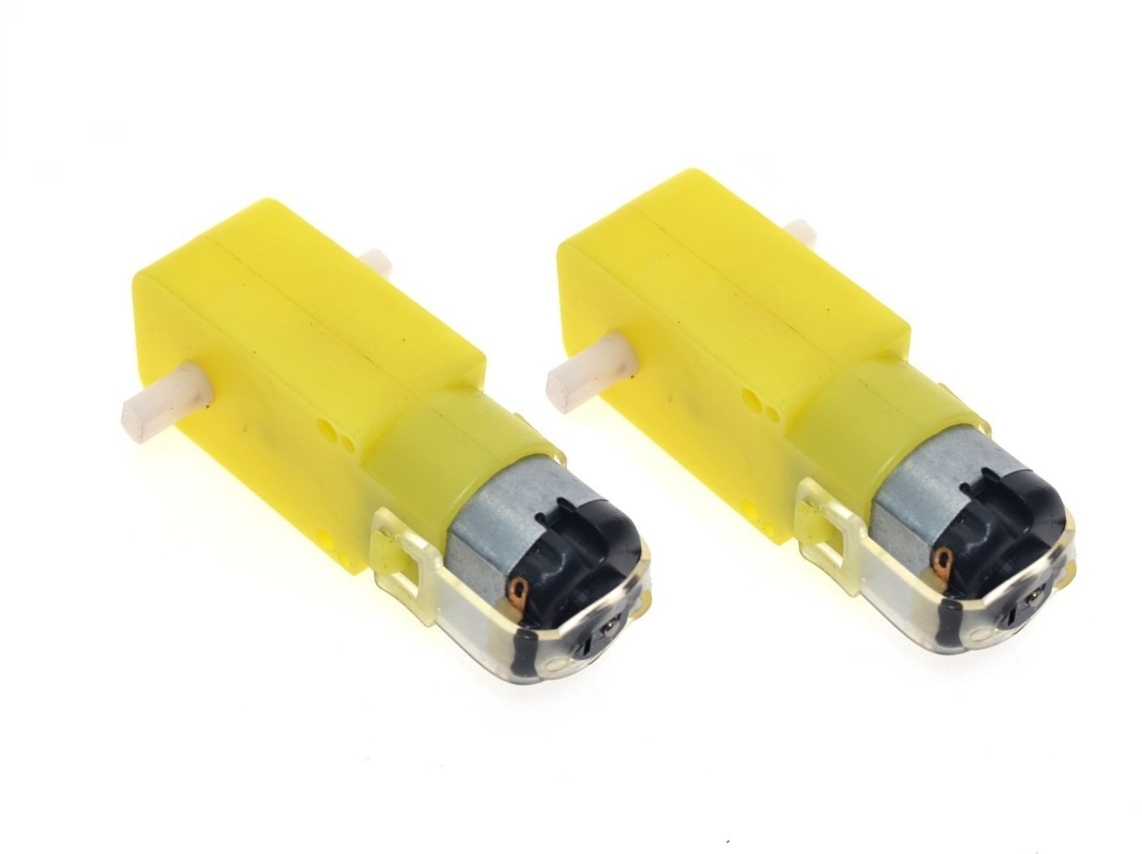
Components
AMIT KIT
Chassis
2 DC motors

Slide 5
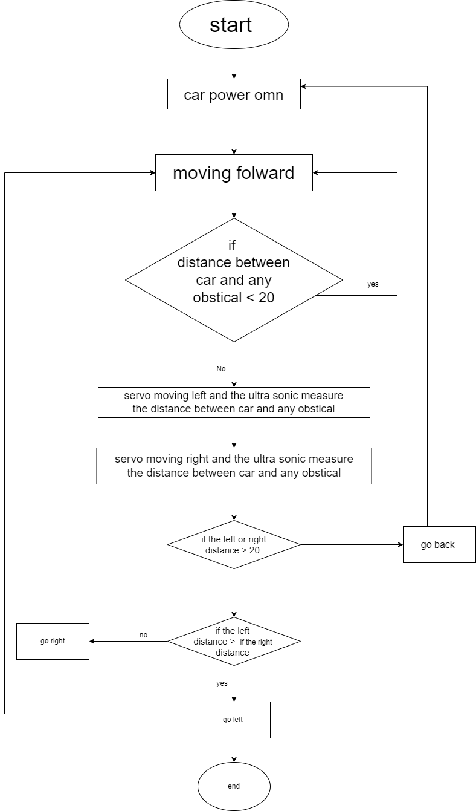
FLOW Chart

Slide 6
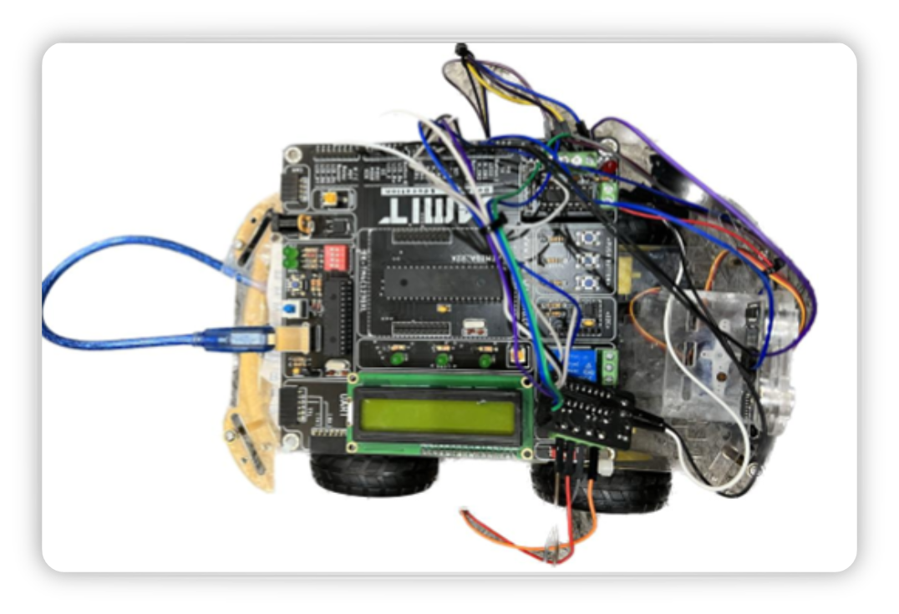
Github Link of the Project :
The autonomous car avoids collision with its surroundings by using a sensor to stop it at a certain distance, then a servo motor attached to the sensor will rotate it 180 degrees to check left and right sides for which position to move to. If the left side distance is greater than right side distance then the robot will turn left and move at the direction, and vice versa. These actions continues indefinitely.
Attached to the robot is a 16x2 LCD that consistently tells the direction the robot is currently heading and the data currently obtained from the Ultrasonic sensor

